Slide 1
SUB-METERING & SMART HOUSES Business Proposition and Exploratory Data Analysis
By SERGI CHIMENO
Iot analytics

Slide 2
INDEX
Objective/Goals
Background
Data Management
Exploratory Analysis
Our Project
Feedback/Recommendations

Slide 3
1 Objective/Goals
Main objective:
Consider transitioning from traditional house building towards smarthouse
Consider if the installation of sub meters and can be beneficial for the builder.
If it's decided to install submetering:
How the submeters should be distributed.
Implement a analytic interface both for the home-builder and home owner

Slide 4
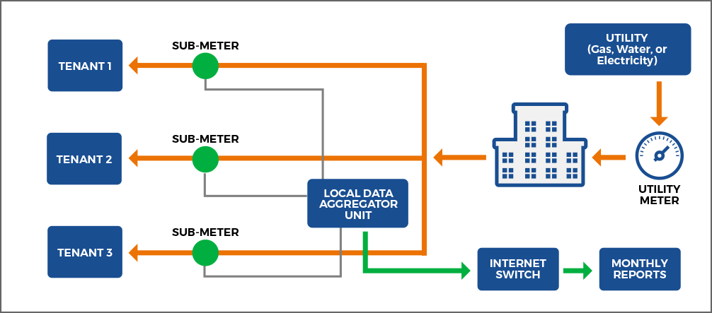
2 What is the background of this project?
Sub metering:
Low cost
Provides full transparency of individual energy consumption to tenants and apartment owners.
Making sure everyone only pays for what they actually consume.
Smart Homes:
Pros:
1. Providing consumers with better information through technology.
Endesa's Nexo Smart Home service, using Smart Plugs.
2. Automation in the smart home
3. Healthier and Eco-friendlier enviroment

Slide 5

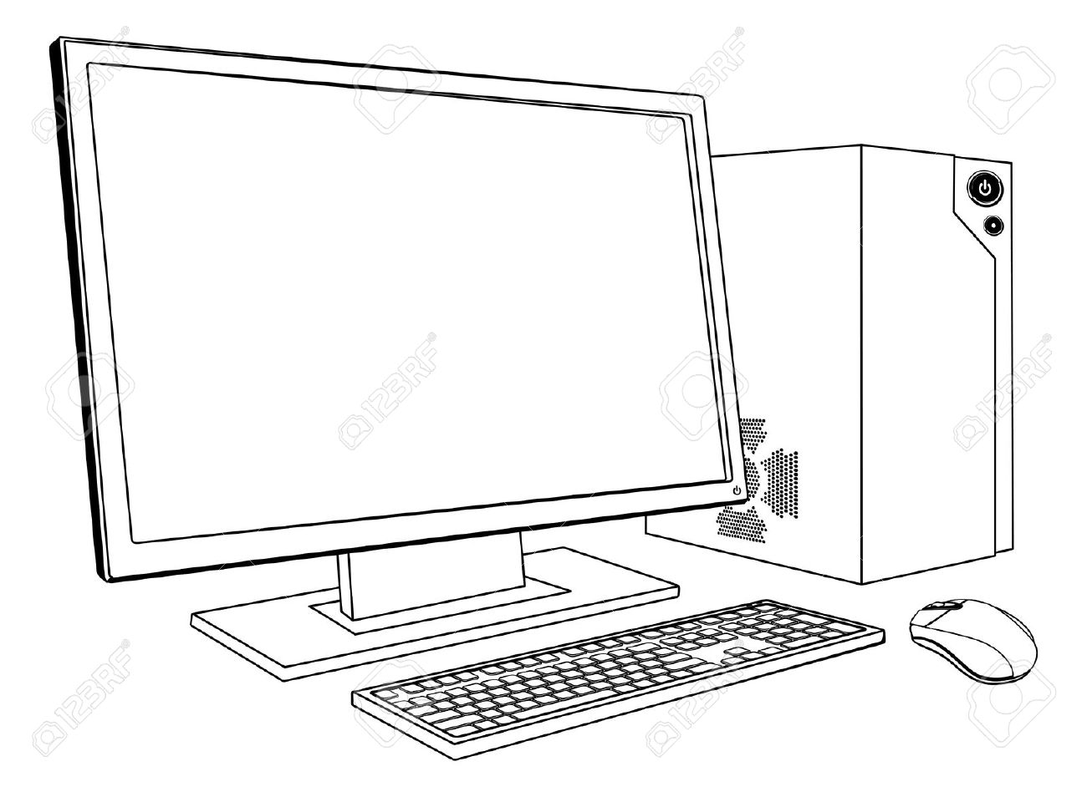
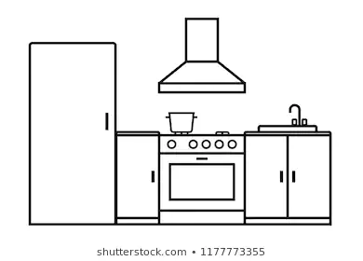

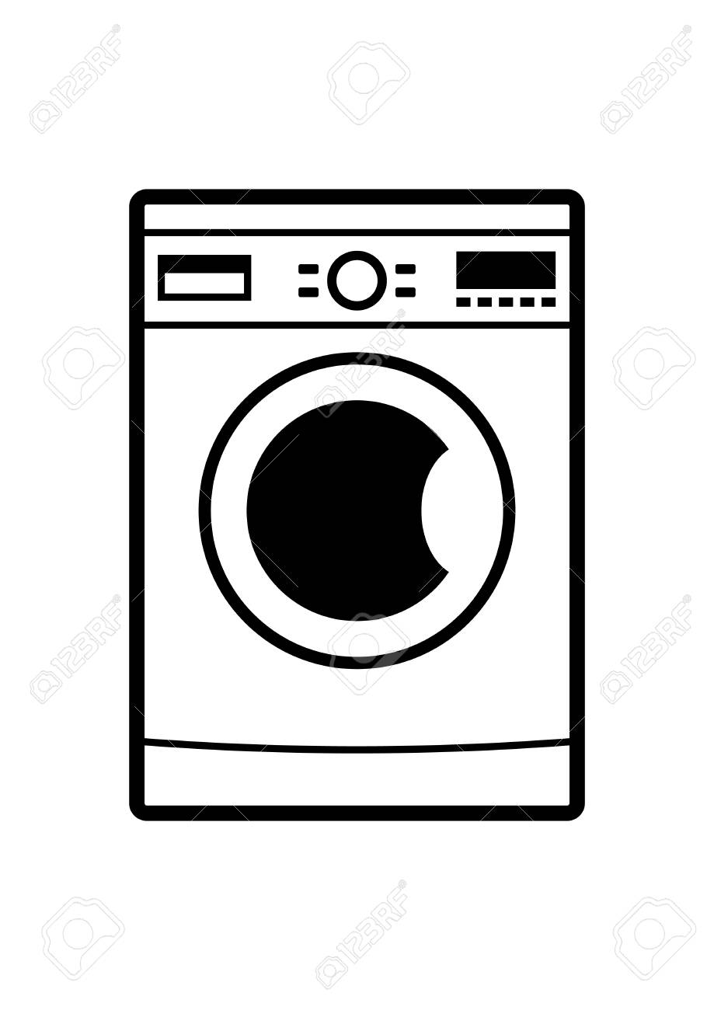

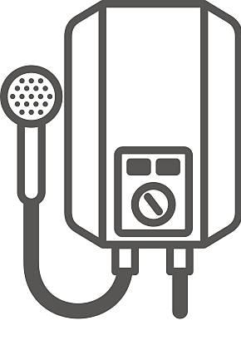

3 DATA MANAGEMENT
- Date & Time
- Active Power, Reactive power,
Intensity and voltage.
REMAINING SOURCES
1
2
3

Slide 6
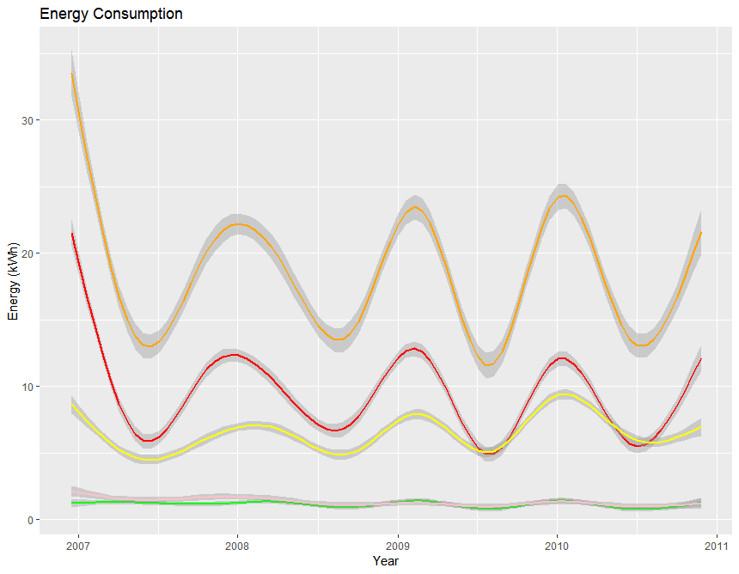
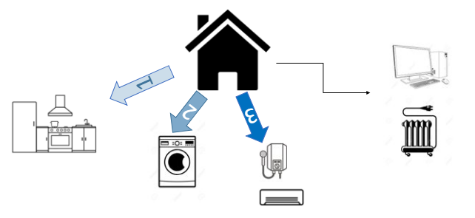
4 EXPLORATORY ANALYSIS
After an exploratory analysis of our data we saw some relevant factors:
Sub-meter 3 uses the most power (heater and air conditioner)
may be a good idea to split them into two different submeters.
Spikes during winter and weekends.
May be the most interesting data frame to focus on how to save power..
Not Submetered power source not specified, but it's shown to be very high.
Knowing the electricty bill rate we can show the money spent (monthly, weekly...).
Some data is unavailable due power outages.
Initial analysis based on a single households, for an intensive analysis towards city building should consider diferentt measurement approach.
Total
No SM
SM3
SM1&2

Slide 7
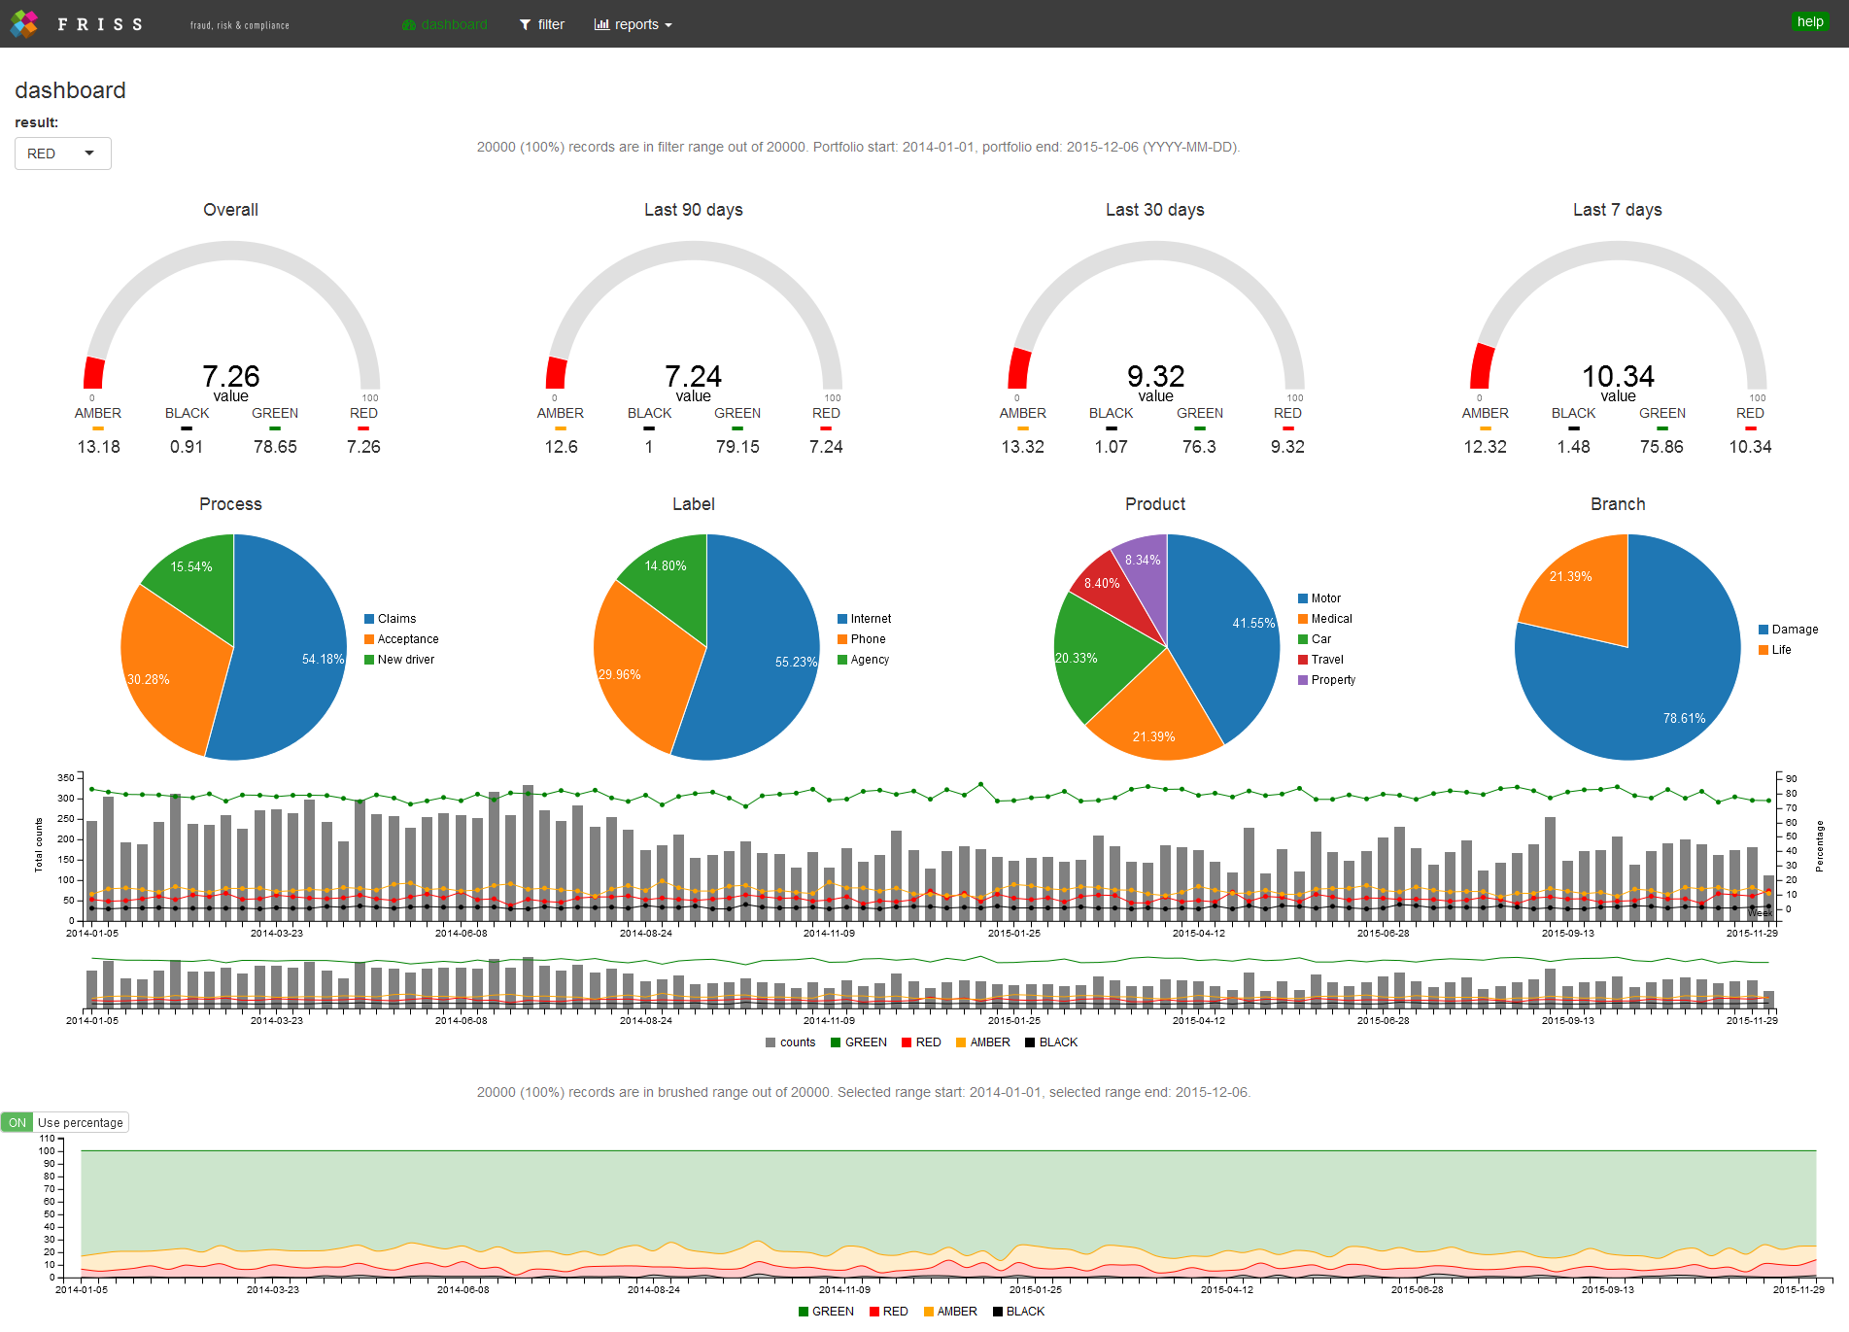
5 OUR PROJECT
Using R-Shiny or similar tools we can implement a very accesible dashboard for the householder:
Our interface will contain:
- Easy to read statistics and graphs
Also including conversion to €/kW according to the hired company rate.
- Power consumption by any time frame available
Yearly, monthly, weekly, daily....
- Power consumption according to the submetering
Kitchen, laundry room...
- Smartphone and computer compatibilty
Check your information anytime, anywhere.
- Anomaly detection -> Instant Notification
Power spikes, shortages, manipulation ...
(Rshiny sample image, final design may change)

Slide 8
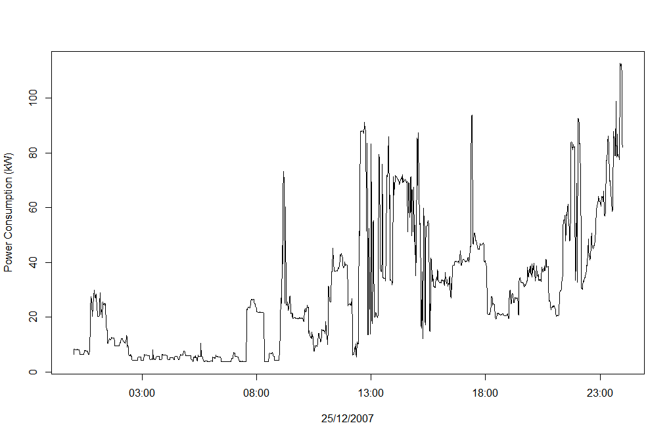
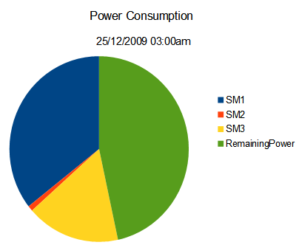
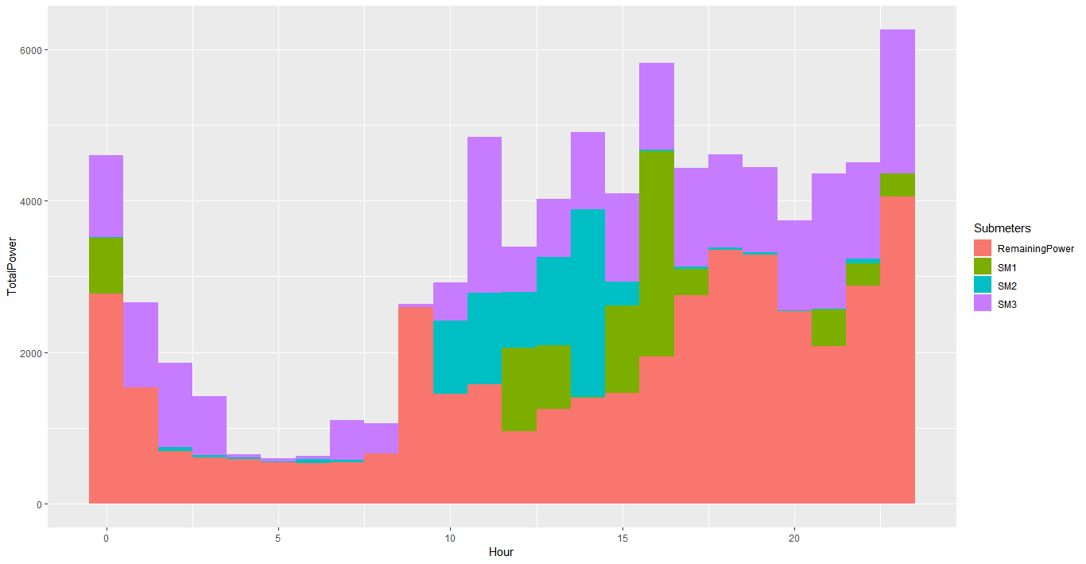
5 OUR PROJECT
Visualization Samples
By hour:
Pie chart
Bar Chart
Continuous diagram

Slide 9
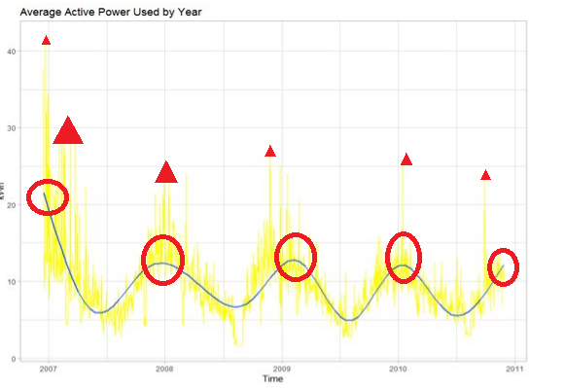
5 OUR PROJECT
Visualization Samples
By year:
With only one sub-meter (Useful for spike detection)
With all sub-meter and remaining (Useful for comparison)

Slide 10
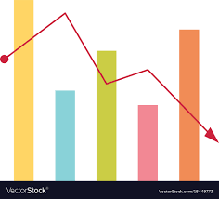
6 PROJECT SCHEDULE
What will our project consist on?
Initial Exploration analysis (1 week)
Build predictive models (1-2 weeks)
Using machine learning to demonstrate our client how the data can be used to make decisions about altering power consumption.
3. Implement the interface software (1-2 weeks)
Make a easy to read interface for the customer
Prepare a more elaborated software for the home builder (may be accesible for the customer too).

Slide 11
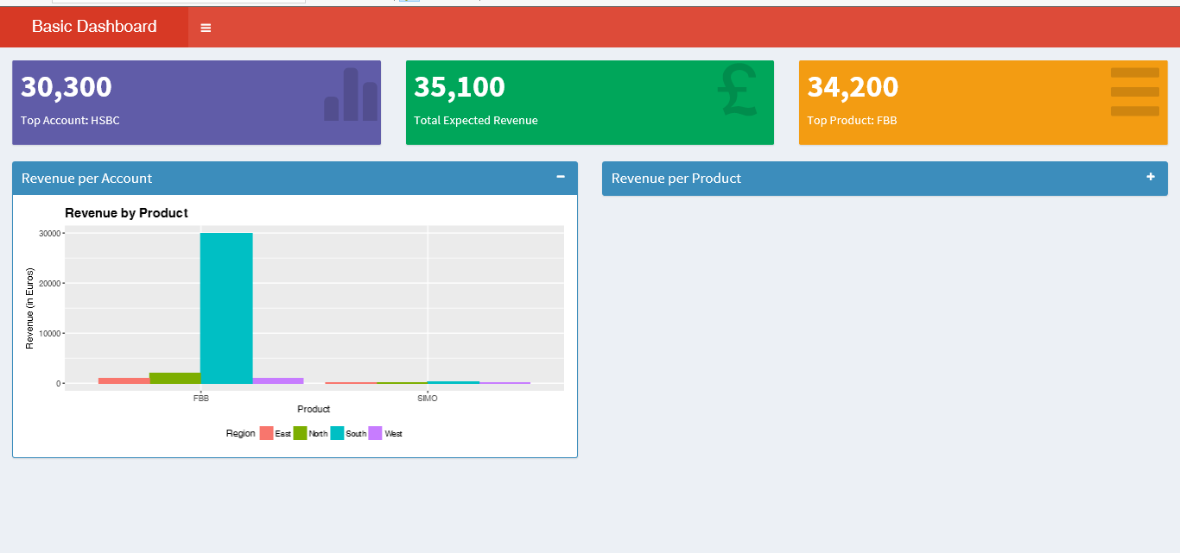
7 FEEDBACK/SUGGESTIONS
Some data given is not useful to our analytics (Voltage and Intensity), data should be given all in same units (kWh).
It is necessary to specify where the Non submetered data comes from.
It is essential to add as many submeters as possible -> if not possible, use submeters to the top power consuming plugs.
Use analytic tools to figure out how to spent less during the most power consuming time frames:
Winter
Weekends
Implement 2 different dashboards for homebuilder (with more detailed data) and home owner (easier to read interface).

Slide 12



7 CUSTOMER OUTPUT
Advantages of installing sub-meters and data aquisition software:
The smart home market: Being up to date with the necessities of the modern family, provides real-time data.
Saving Money: No more excessive charge by the electric companies.
Fair Billing: The owner is able to bill electric-use to individual apartments on an actual-consumption basis.
Eco-friendly enviroments: When property owners do not charge for utilities separately, residents have little reason or incentive to conserve energy

Slide 13
Thank you
By SERGI CHIMENO
Iot analytics

